Slide 1
AAPL v AMZN v GOOG
In the current conditions, which company, if any, would you recommend for a long-term investment.
-What is the past, current and predicted future trend?
-What is the current rate of change in share price versus financials?
-Which company would be the best choice based on financials?

Slide 2
Summary of Companies Selected
Apple (AAPL) designs and sells electronic devices such as the iPhone, iPad, Mac, Apple Watch, Air Pods and Apple TV. The company also offers services such as Apple Music, iCloud, Apple Care, Apple TV+, Apple Arcade, Apple Card and Apple Pay. The integrated hardware, software and services are sold in company-owned stores or third-party retailers.
Alphabet (GOOG) is a holding company for the internet giant Google where most of the revenue (85%) is from online ads. Other revenue is from the sales of apps, Google Pay, YouTube as well as cloud service fees and other licensing revenue. They invest in health (Verily), faster internet (Google Fiber), self-driving cars (Waymo). Operating revenue has been 25% to 30%.
Amazon (AMZN) is a leading online retailer and e-commerce aggregator. Net sales are about $ 386 billion and approximately $ 578 billion in estimated physical/digital online gross merchandise. Retail accounts for 80% of total revenue, 10%-15% for Amazon Web services cloud computing, 5% in advertising services. International sales are strong in Germany, United Kingdom and Japan.

Slide 3
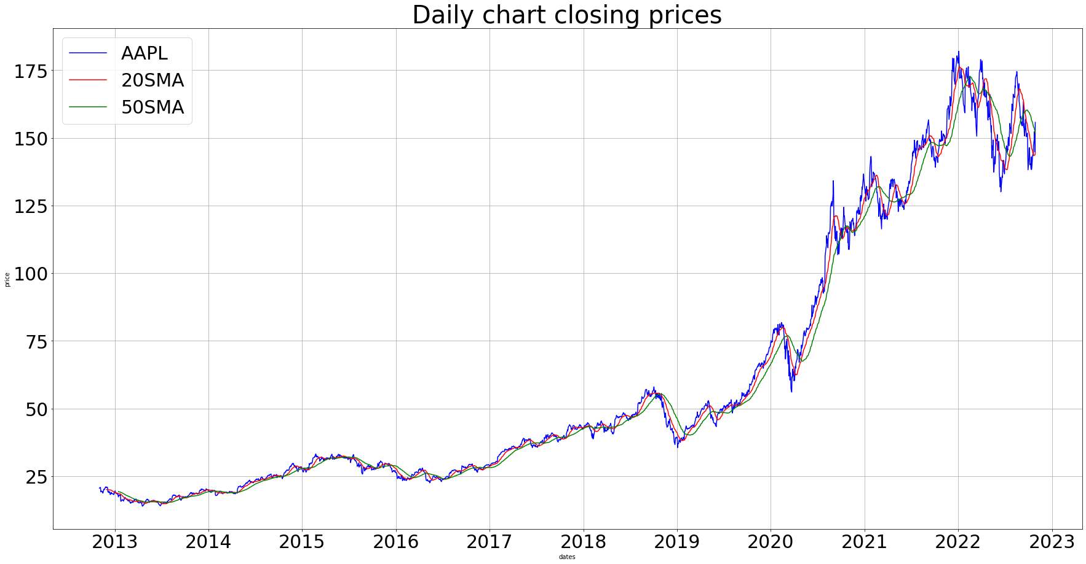

Slide 4
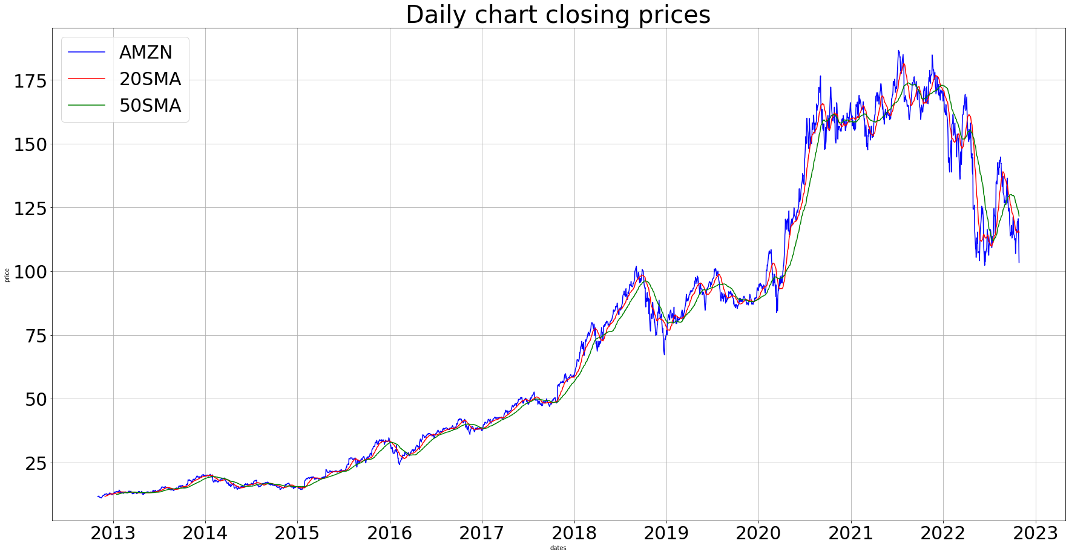

Slide 5
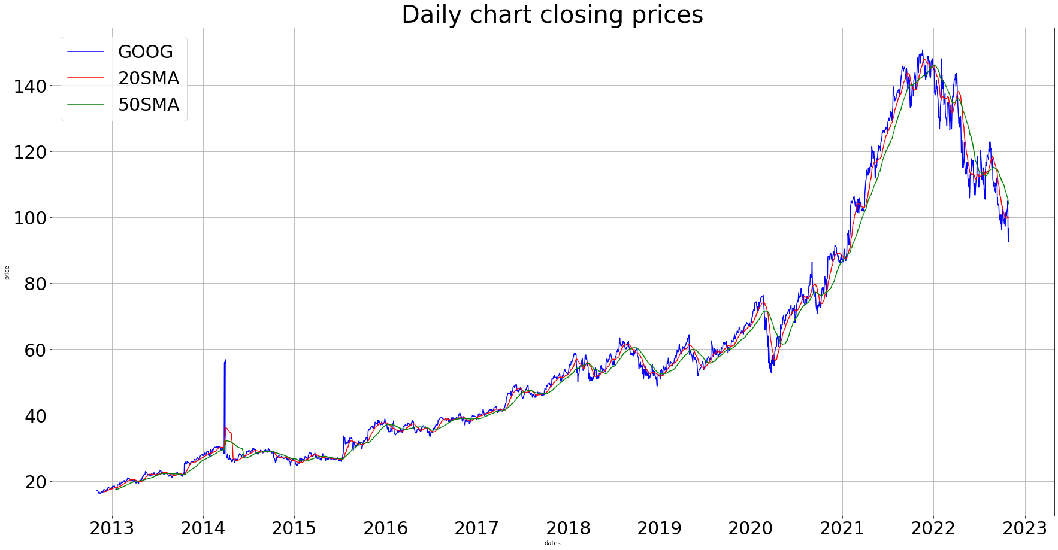

Slide 6
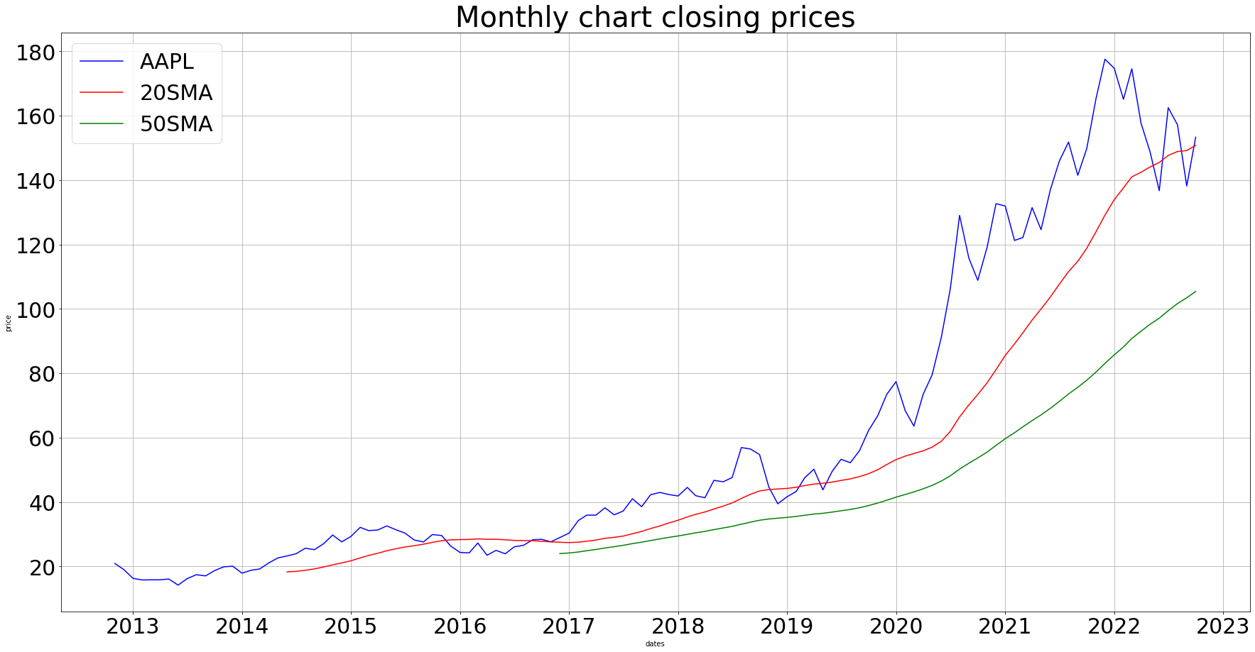

Slide 7
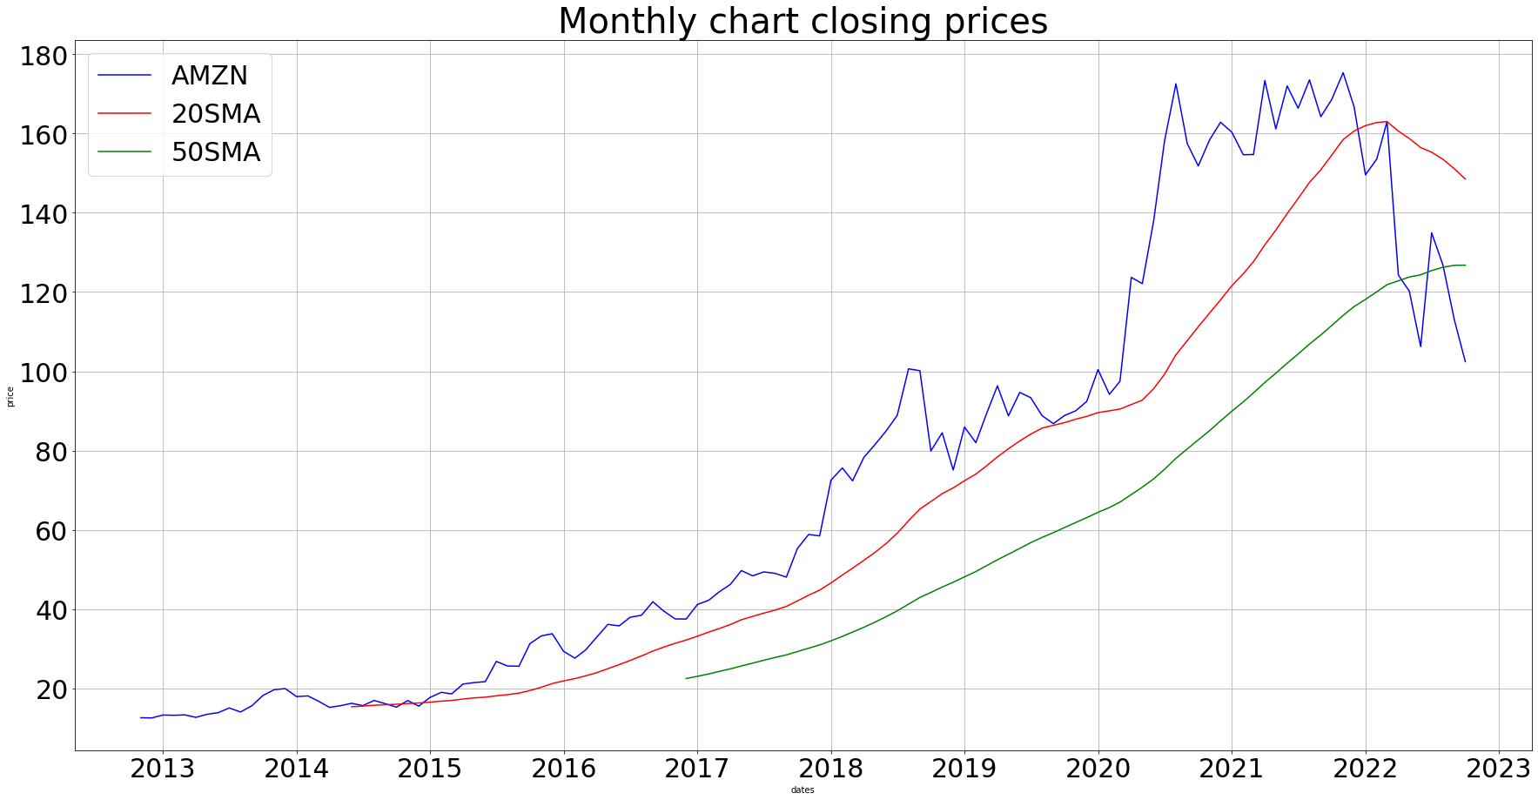

Slide 8
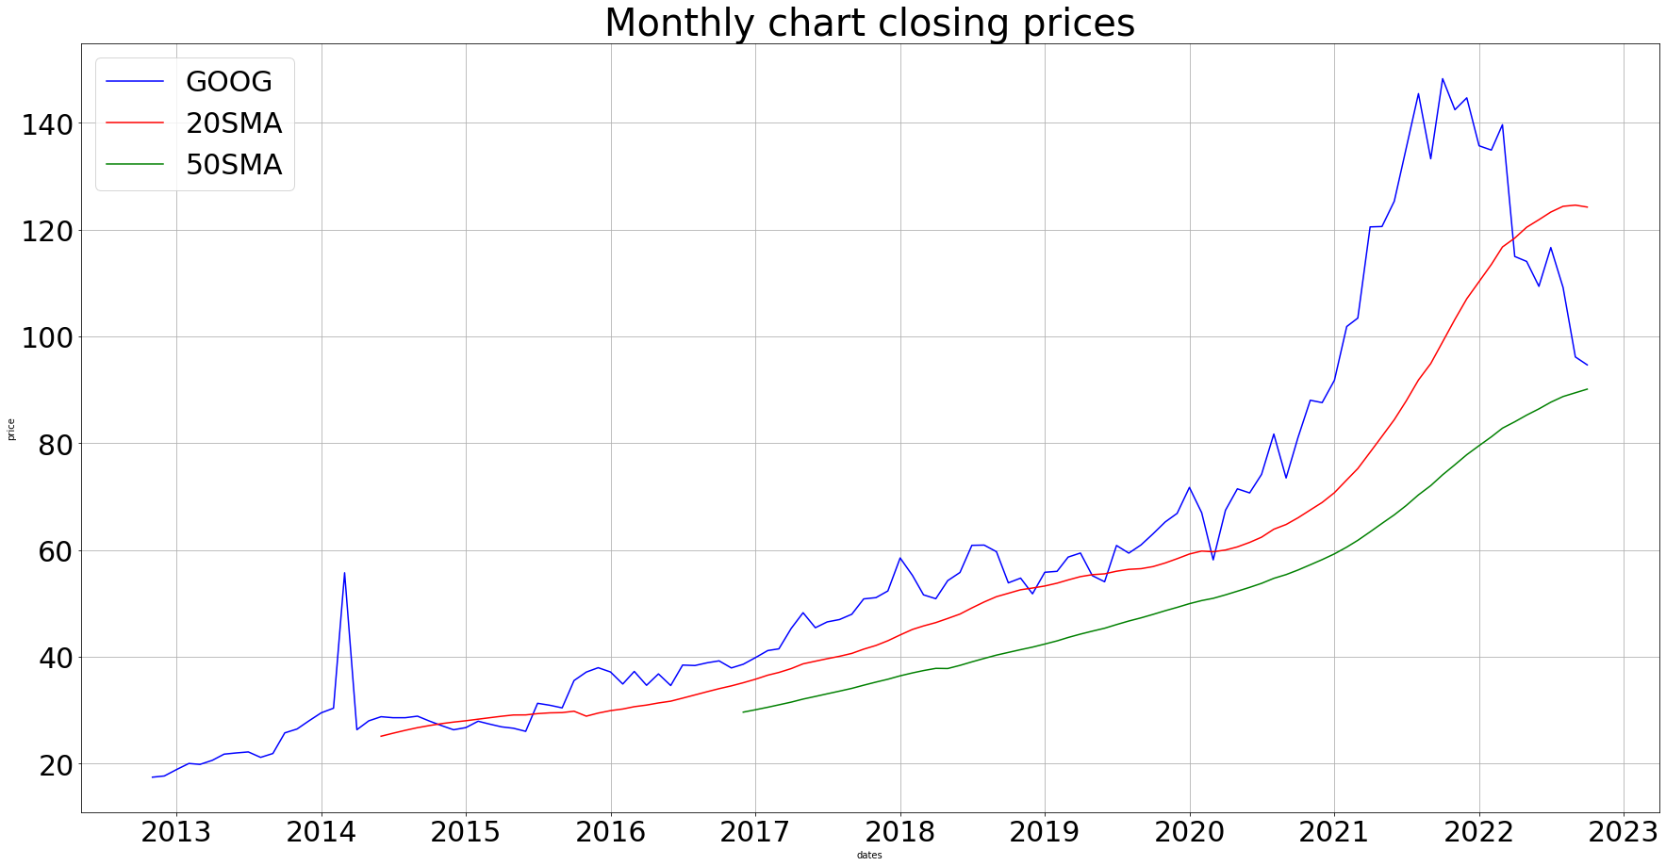

Slide 9
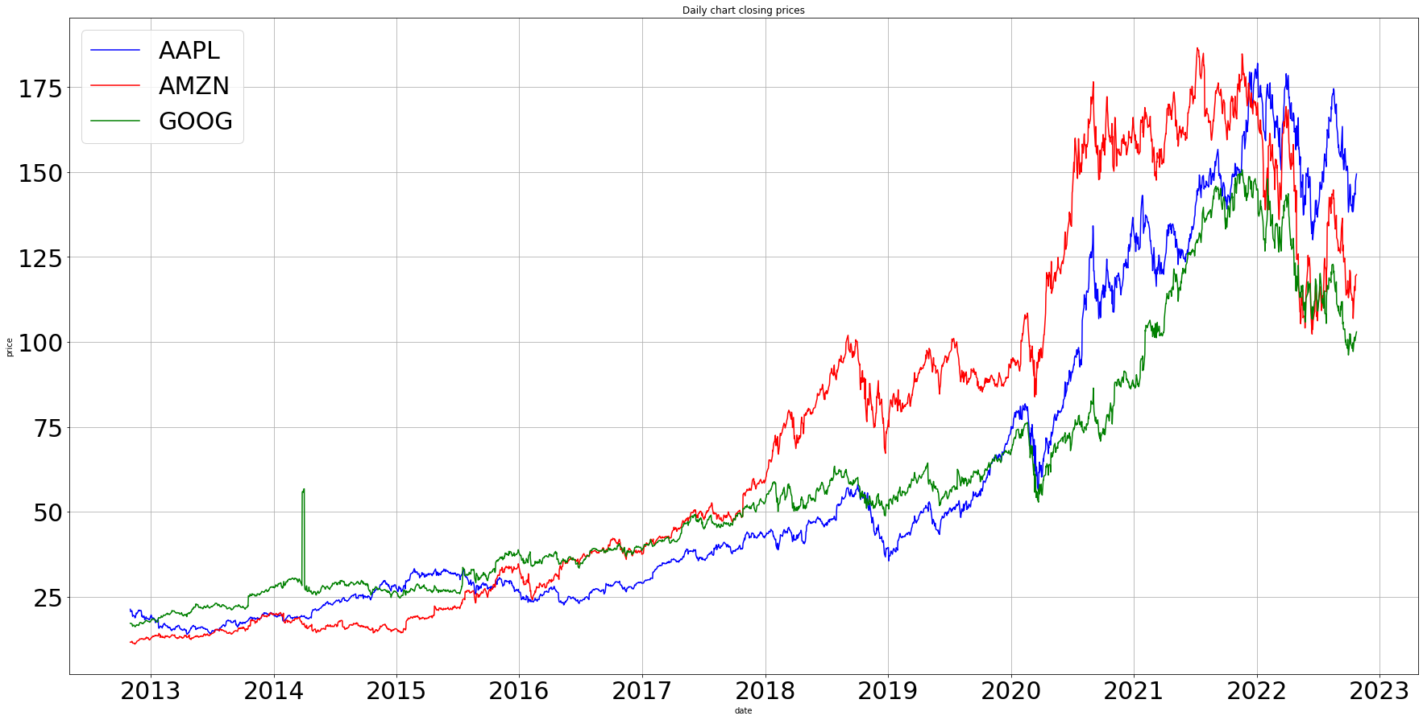

Slide 10
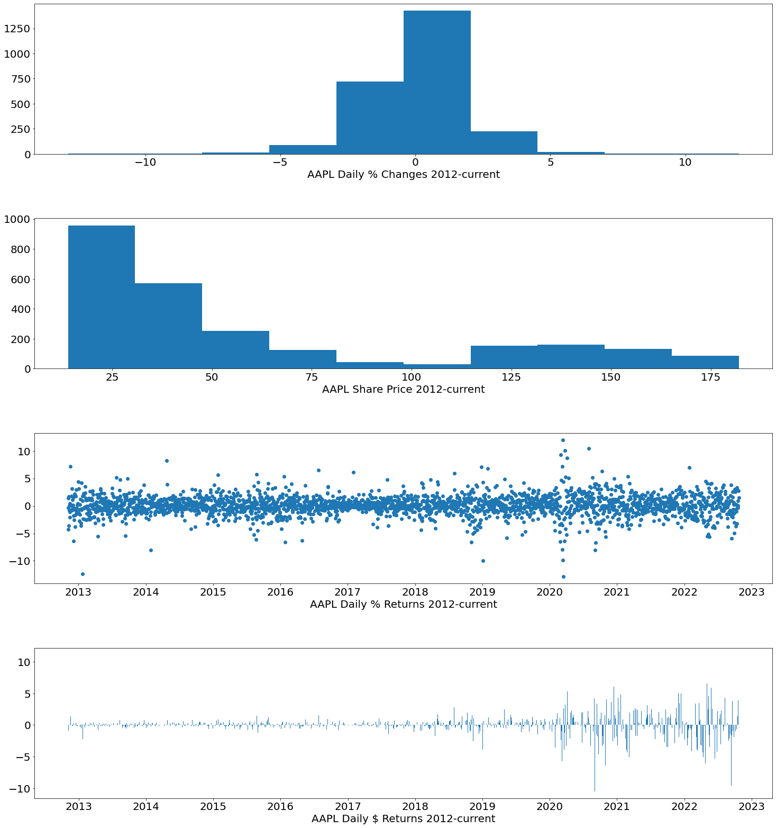
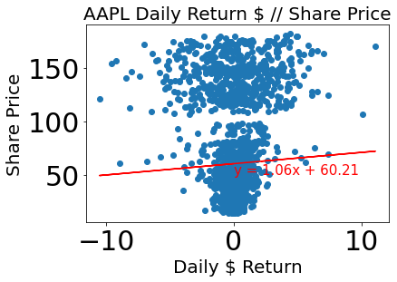
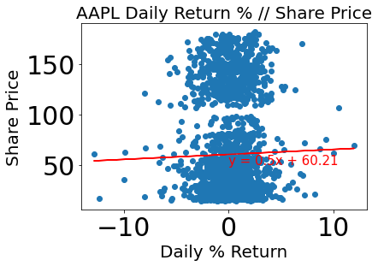

Slide 11
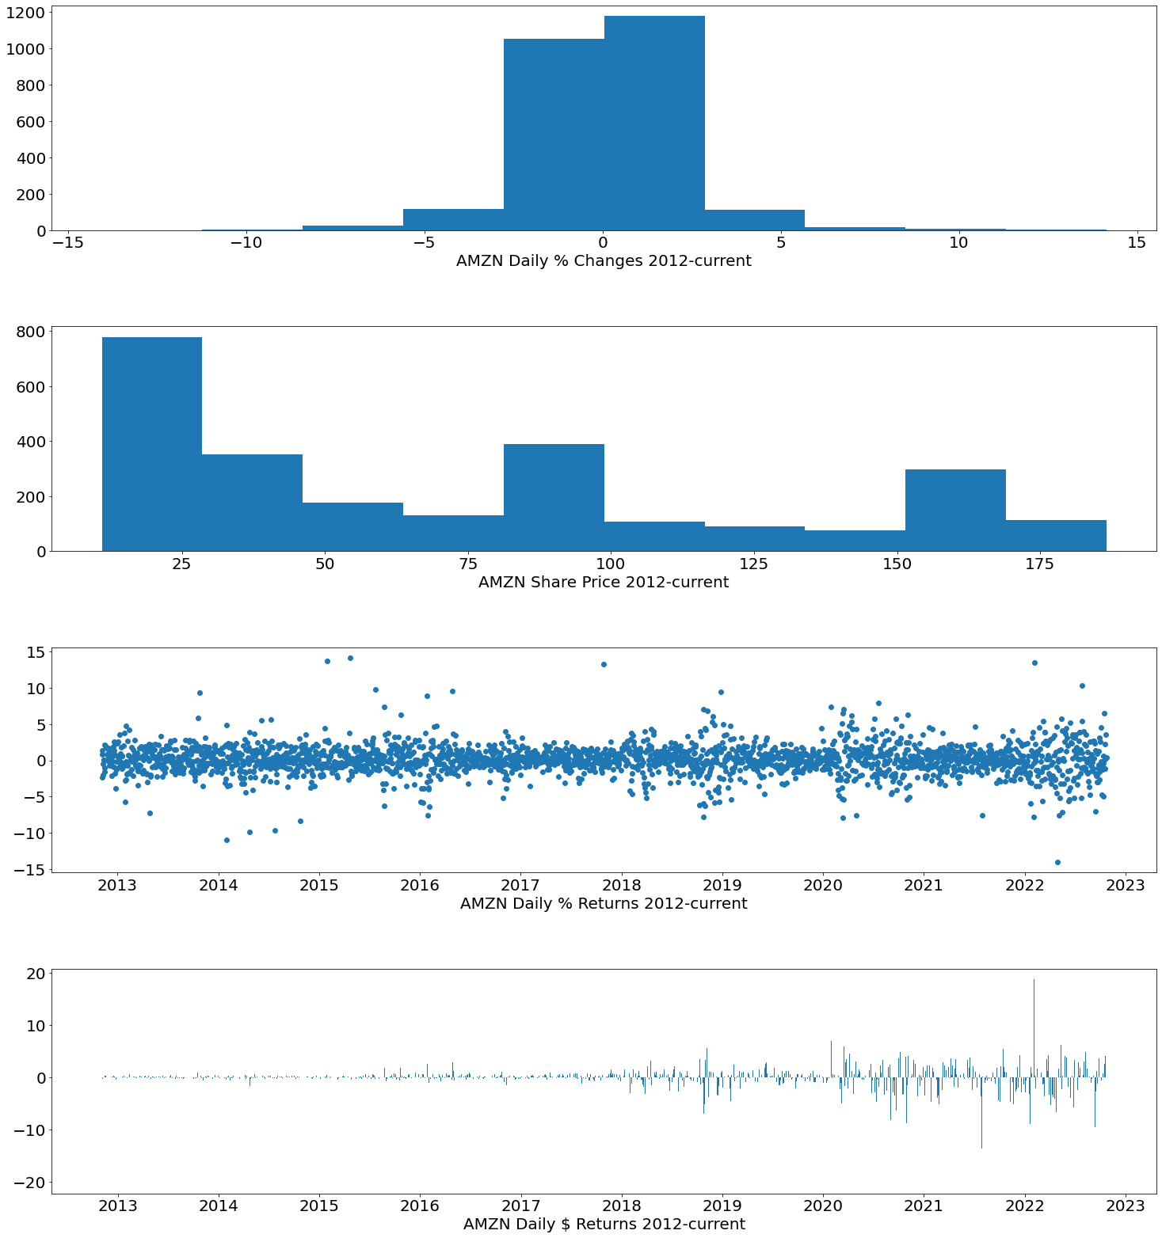
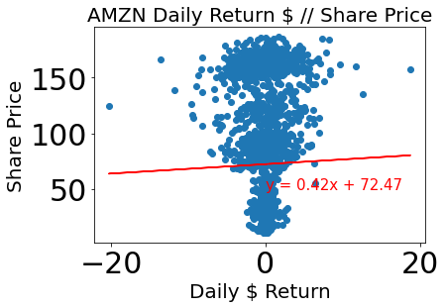
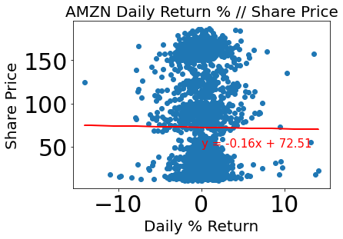

Slide 12
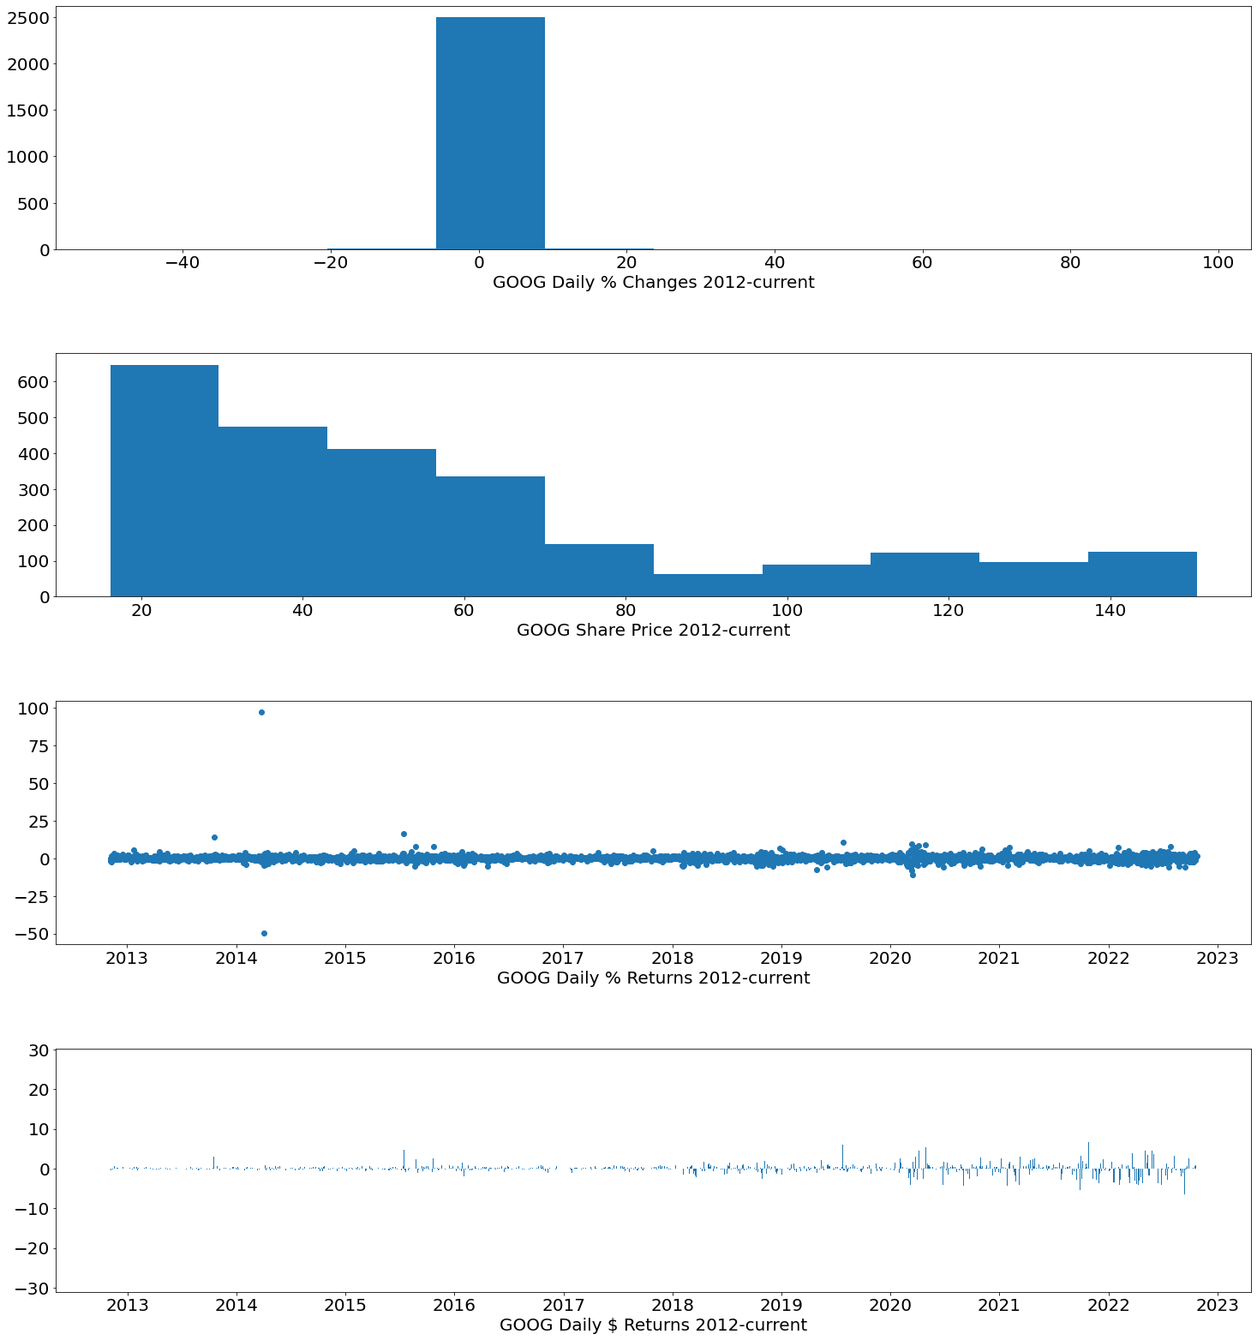
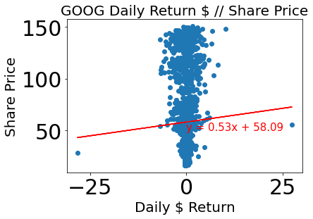
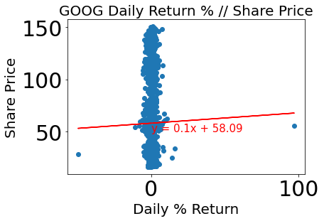

Slide 13
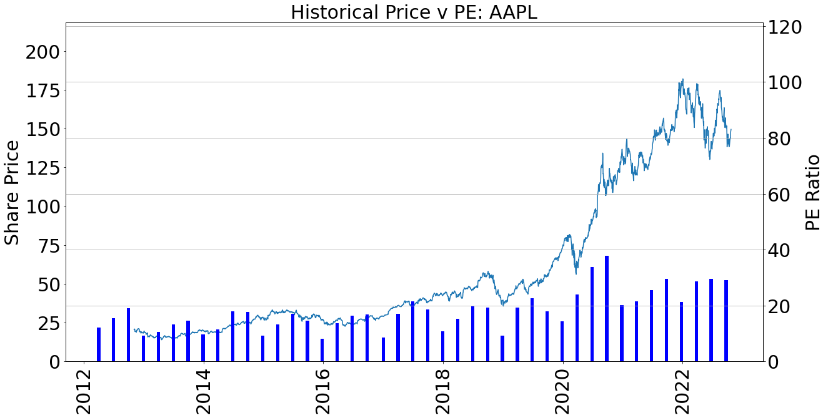
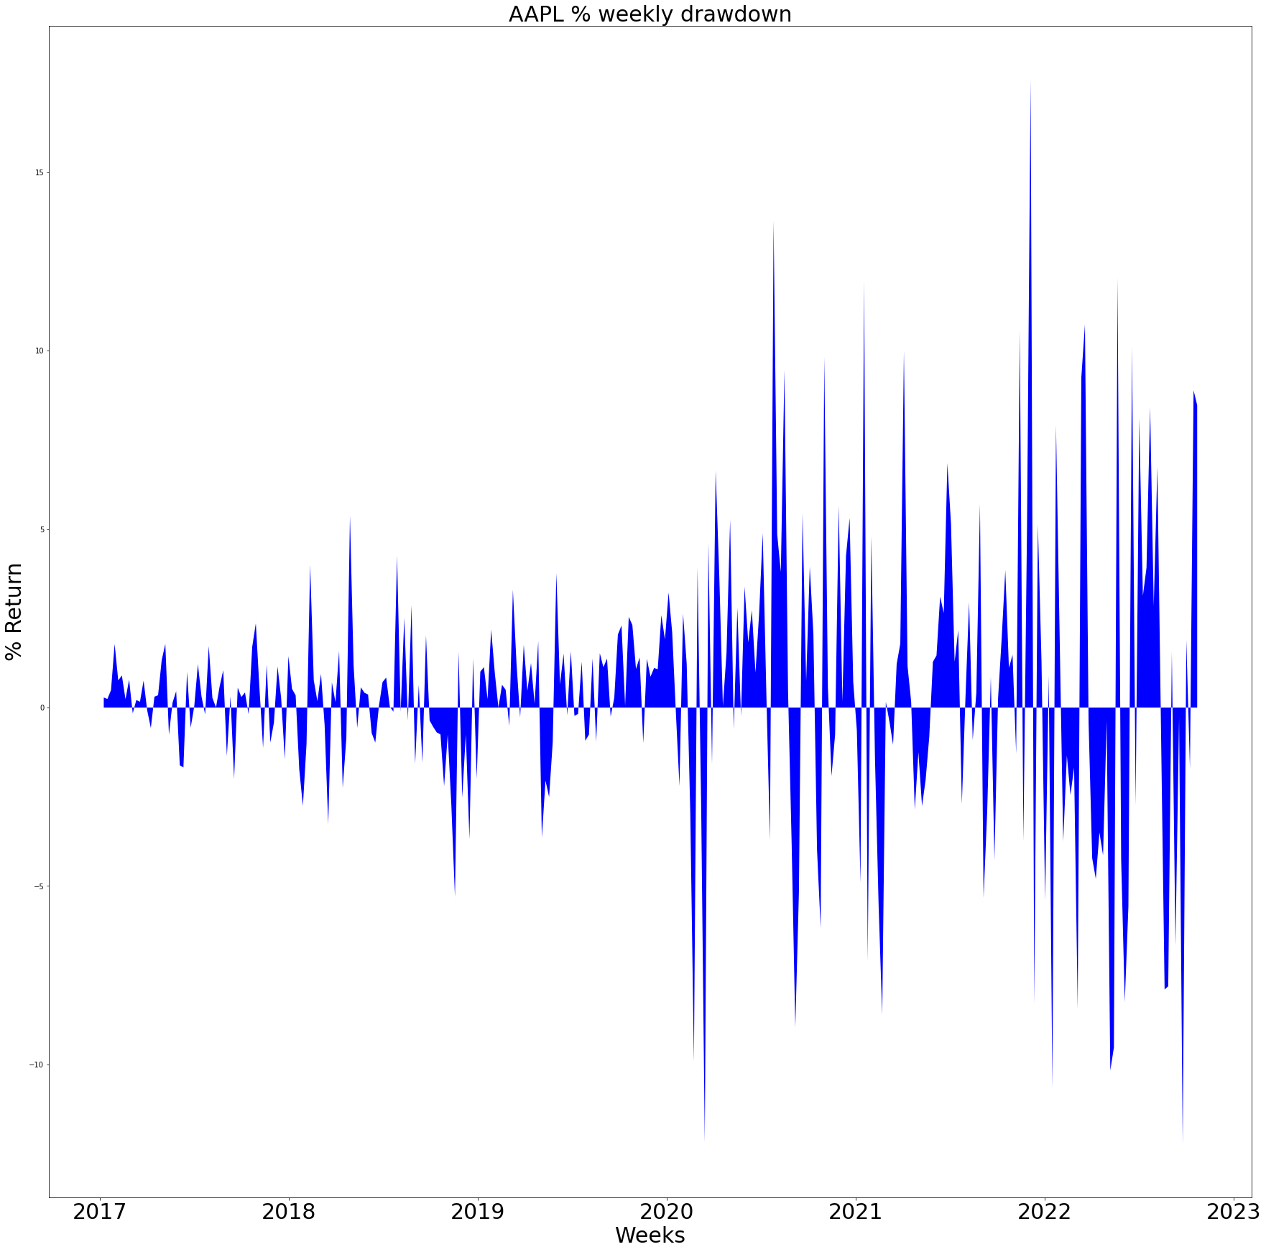

Slide 14
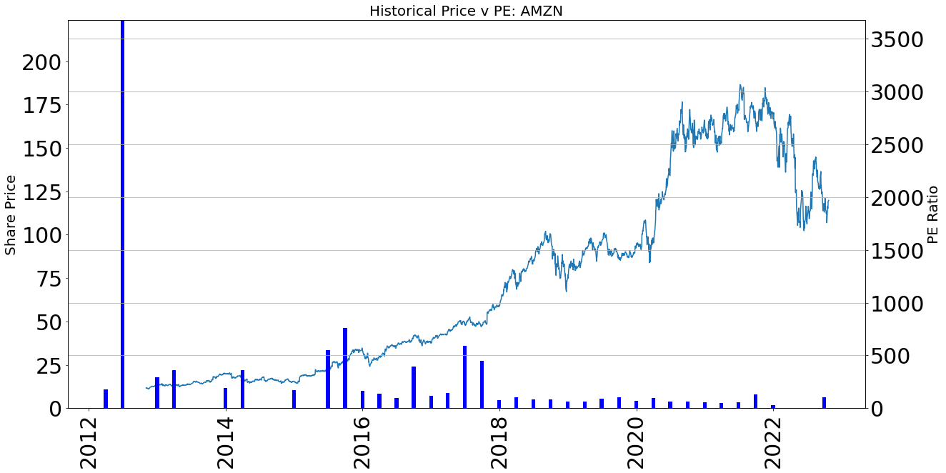
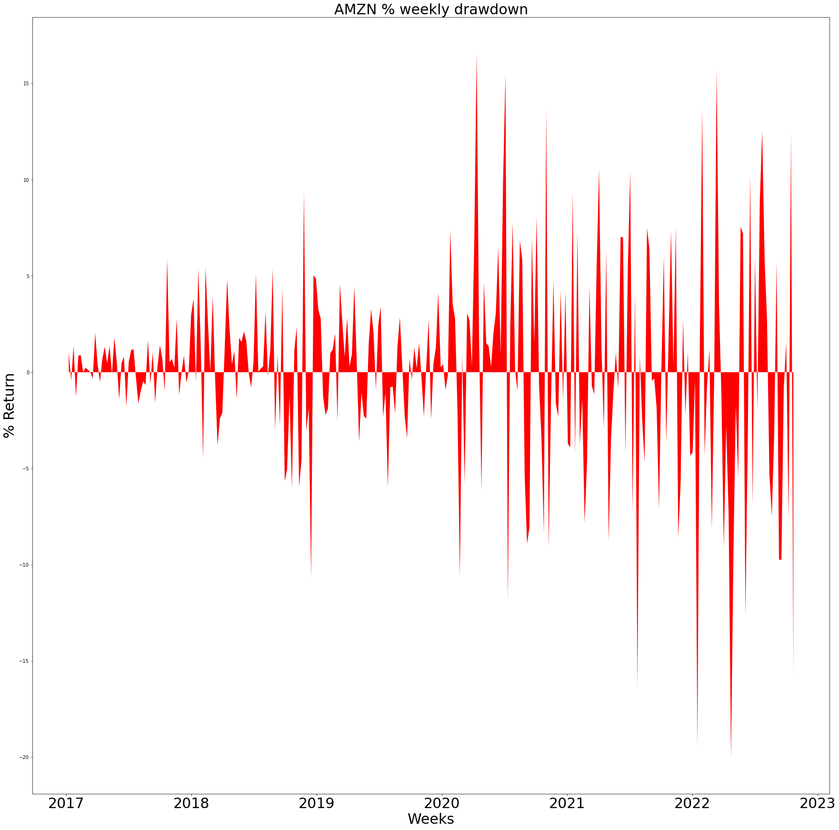

Slide 15
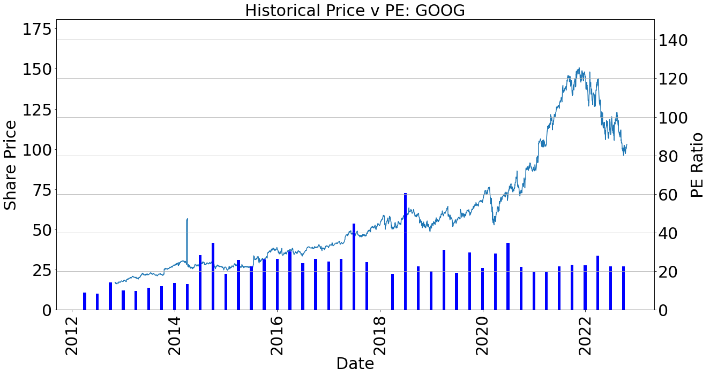
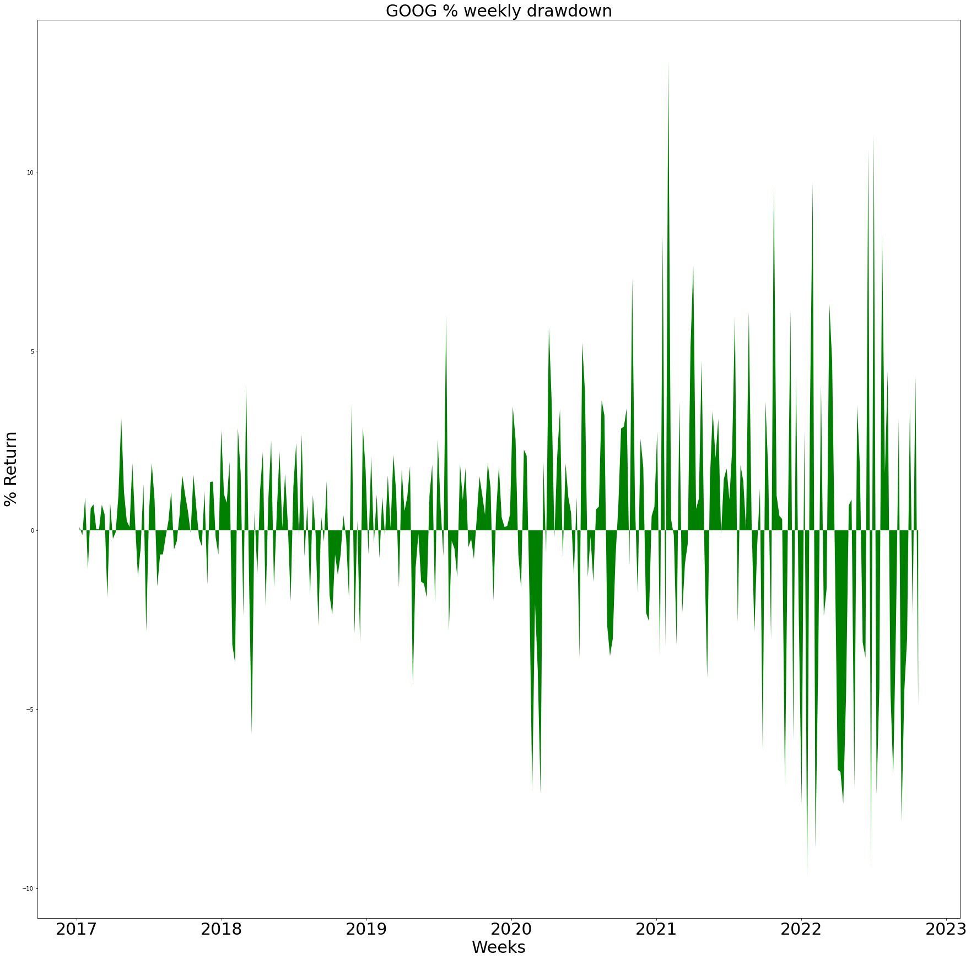

Slide 16
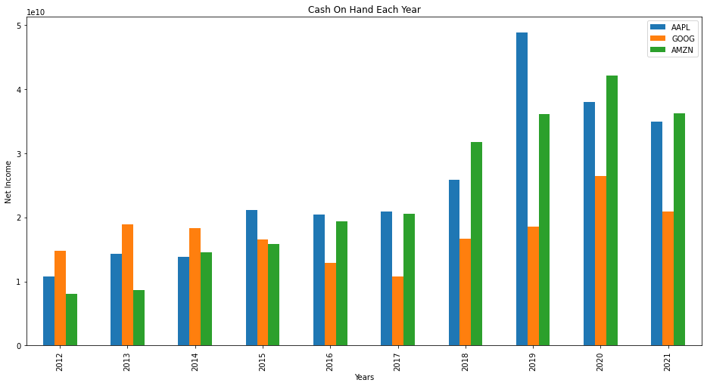

Slide 17
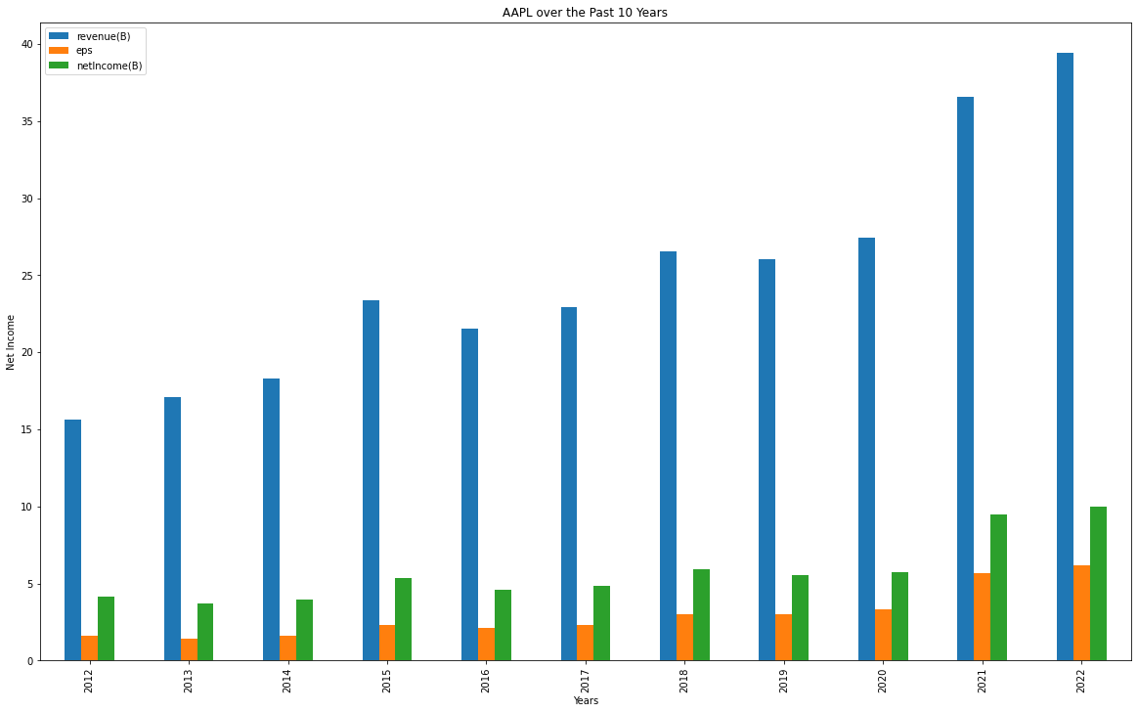

Slide 18
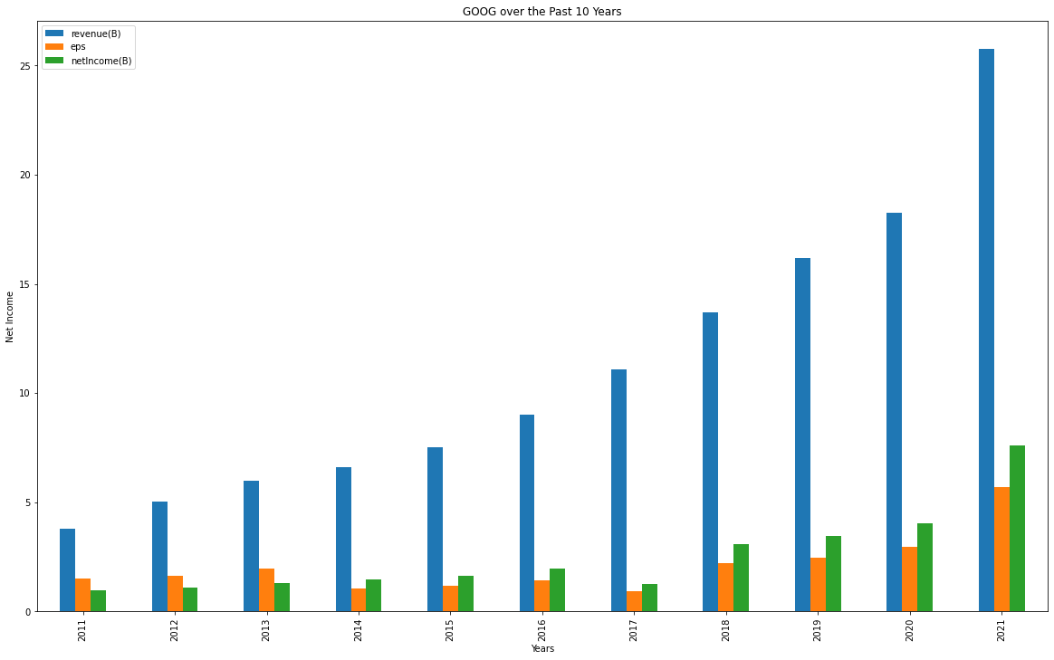

Slide 19
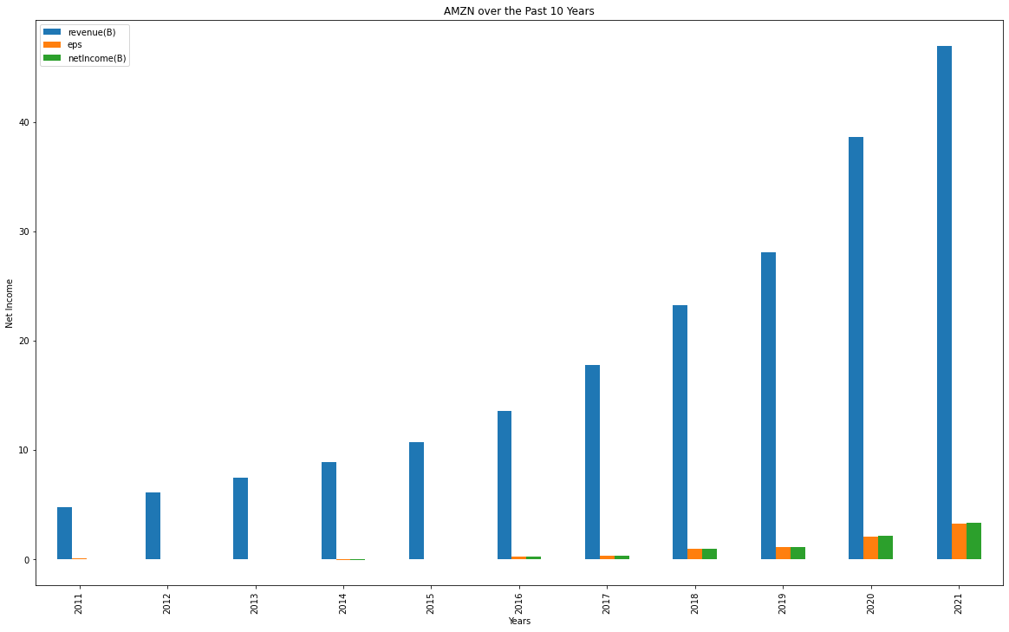

Slide 20
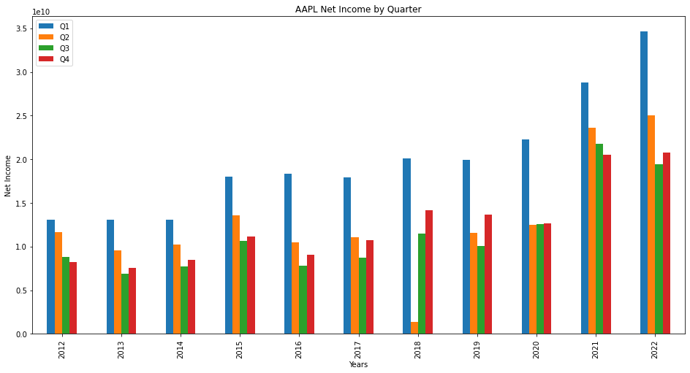
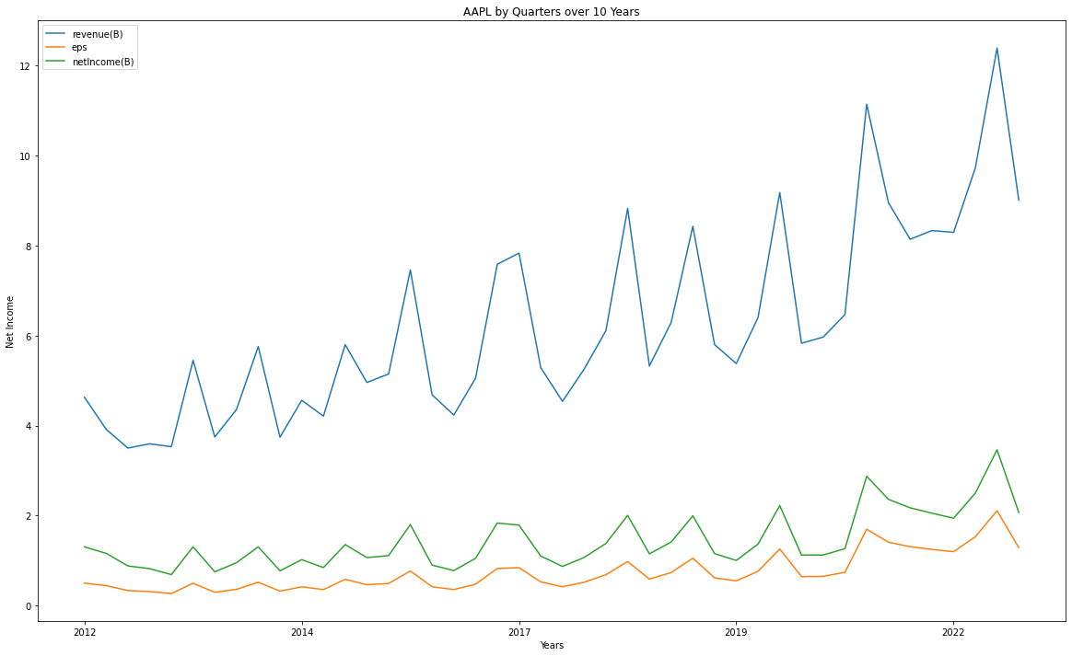
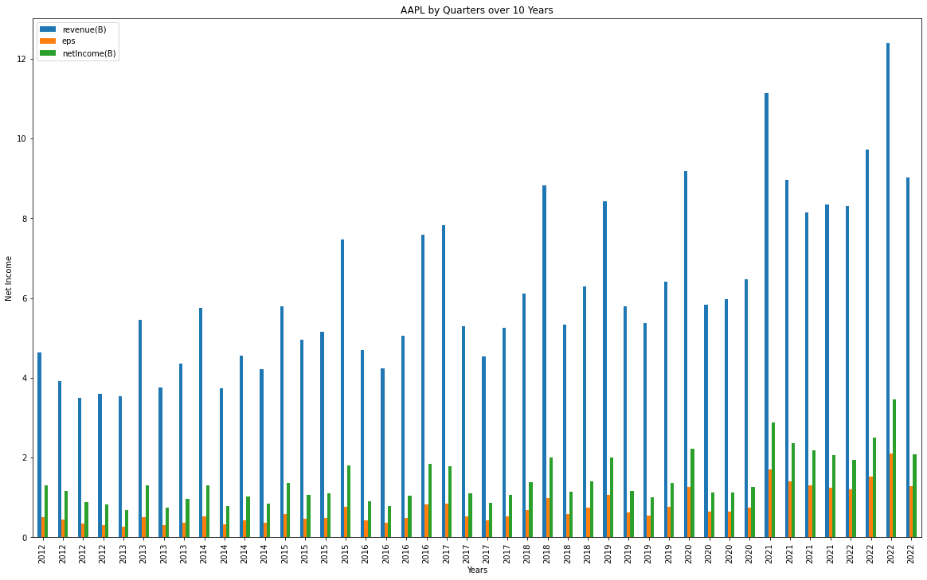

Slide 21
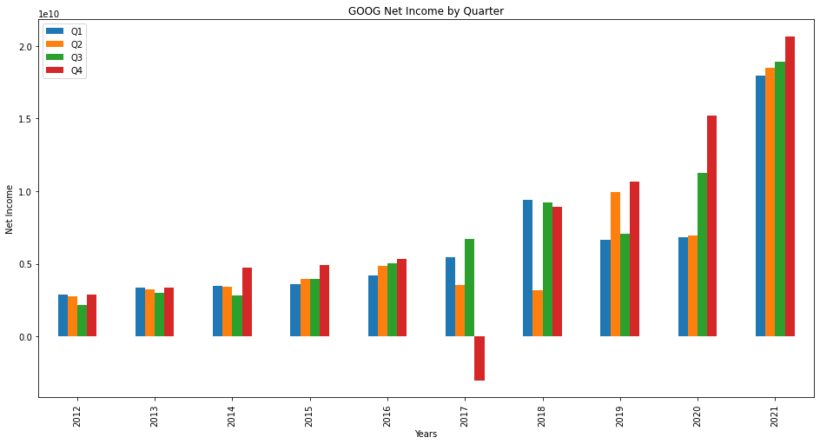
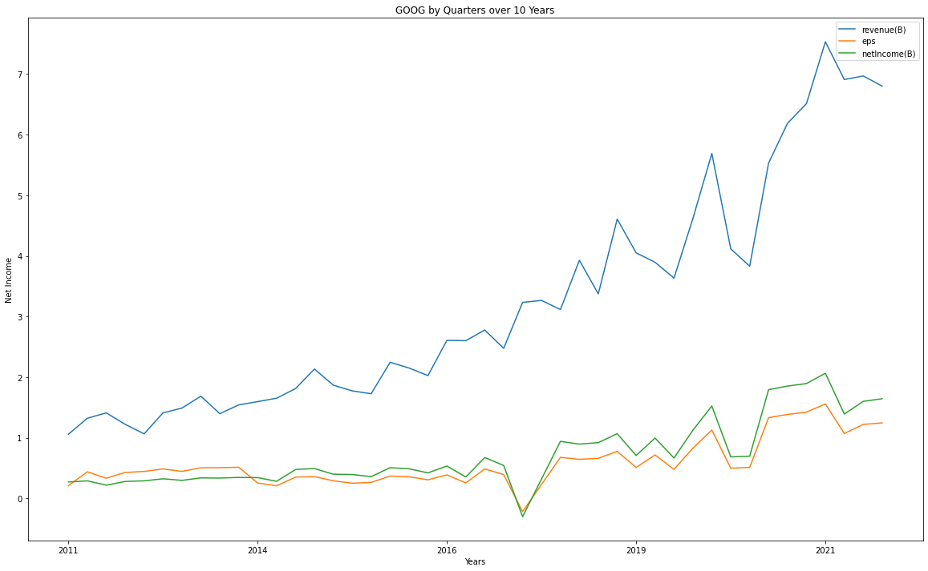
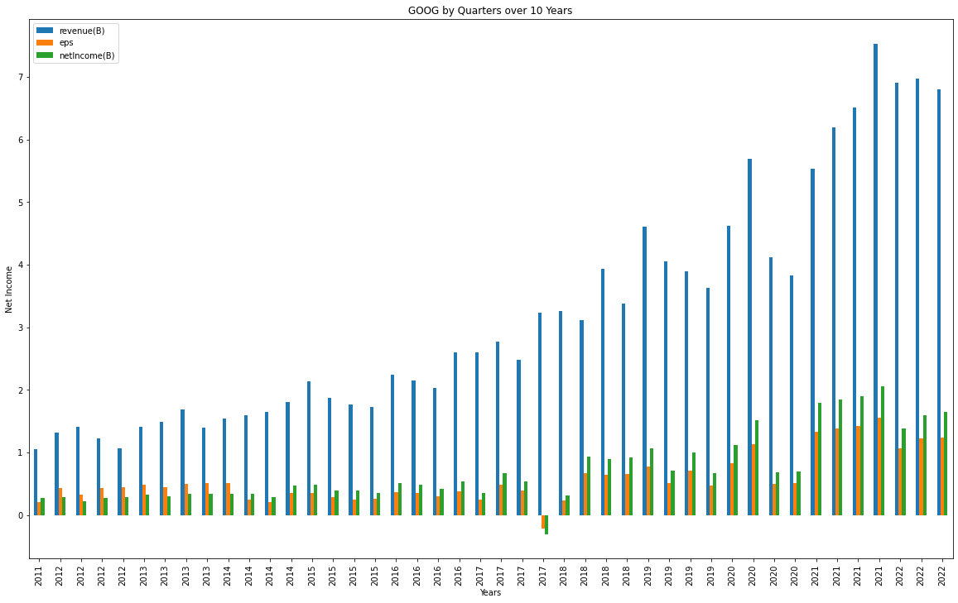

Slide 22
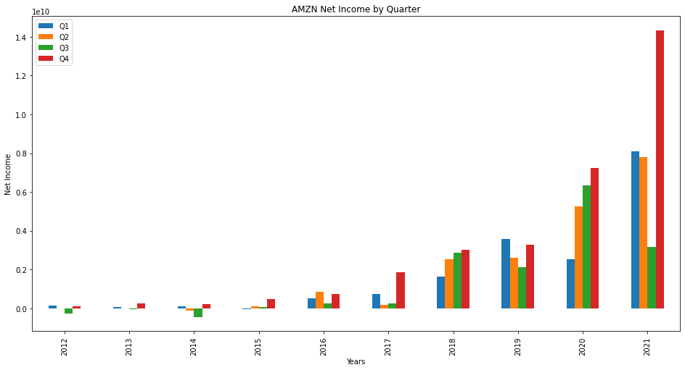
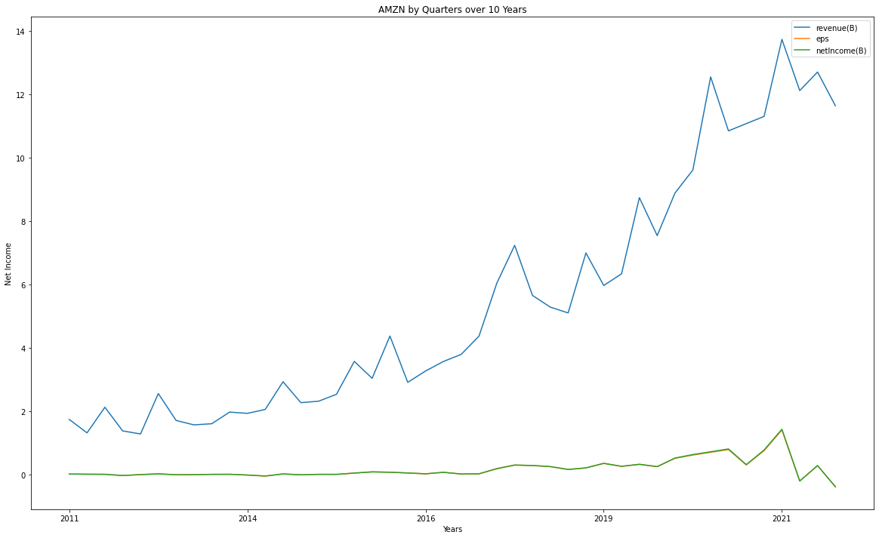
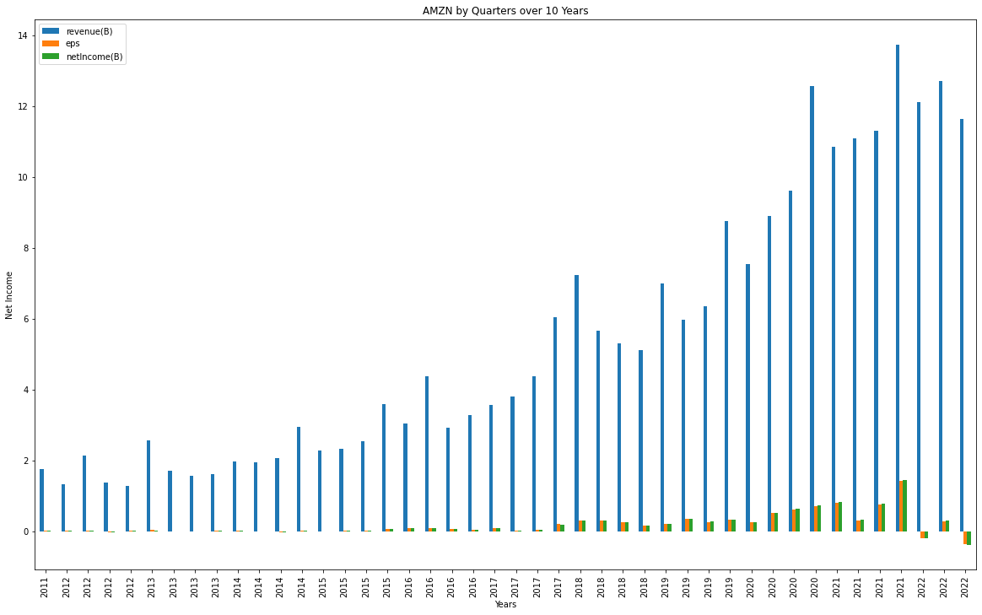

Slide 23
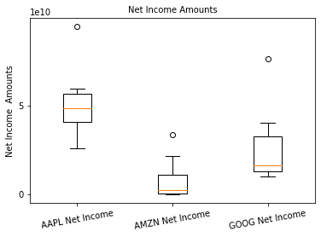
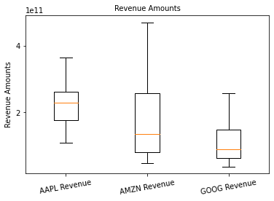
Net income p-value=0.0360052536081312 Revenue p-value=4.768592742344541e-06

Slide 24
Conclusion
Stefanie: In conclusion, using Polygon.io it appears the trend of the close price with the 20 day Simple Moving Average and the 50 day Simple Moving Average (seen by day and seen by month) has less downtrend for APPL followed by GOOG.
Lyndsay: Due to the rate of change in revenue and share price, I would have to assess my risk & understand more about sustainability going forward; that being said, I would not recommend any at this time.

